Slide 1

Relevance Ranking in the Scholarly Domain
Tamar Sadeh, PhD

Slide 2
1
2
3
Notes:
1. What is relevance ranking, and specifically in the scholarly domain?
2. How do we assess the quality and accuracy of relevance ranking algorithms?
3. Some examples.

Slide 3
0
Notes:
But before that, how come we managed without it for decades and now it becomes such a hot topic?

Slide 4
Notes:
Hundreds of millions of documents
Unique, local collections and global materials
Many material types
Heterogeneous user population
Lack of search literacy
Short attention span

Slide 5
1
2
3
Notes:
1. What is relevance ranking, and specifically in the scholarly domain?
2. How do we assess the quality and accuracy of relevance ranking algorithms?
3. Some examples.

Slide 6
“Information technology is not elusive; relevance is. Information technology is tangible; relevance is intangible. Information technology is relatively well understood formally; relevance is understood intuitively. Information technology has to be learned; relevance is tacit. Information technology has to be explained to people; relevance does not.”
Saracevic, 2007

Slide 7
Relevance is the measure of correspondence between a document and a query as determined by a user
Based on Saracevic, 1975

Slide 8
?

Slide 9
System or algorithmic relevance
Topical or subject relevance
Cognitive relevance or pertinence
Situational relevance or utility
Affective relevance
?

Slide 10

Relevance ranking is not new to us.

Slide 11
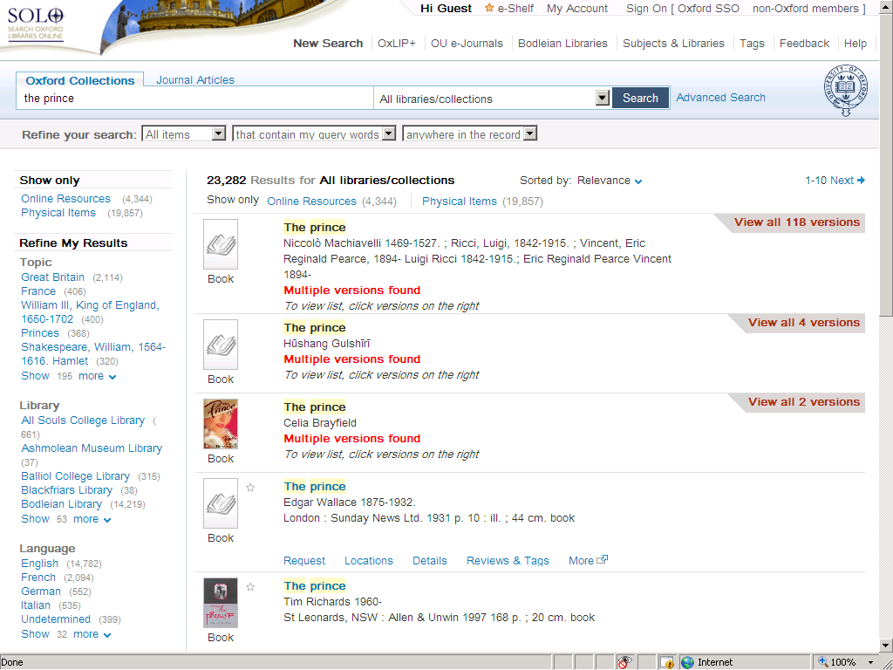

Slide 12
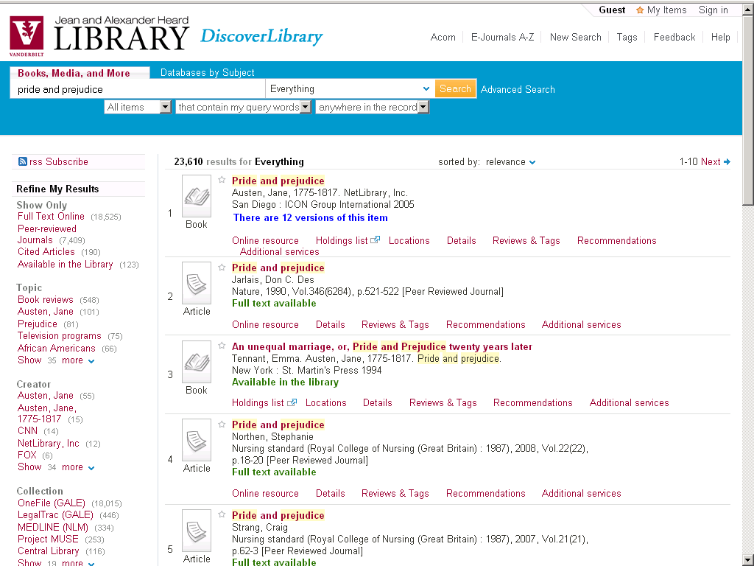

Slide 13
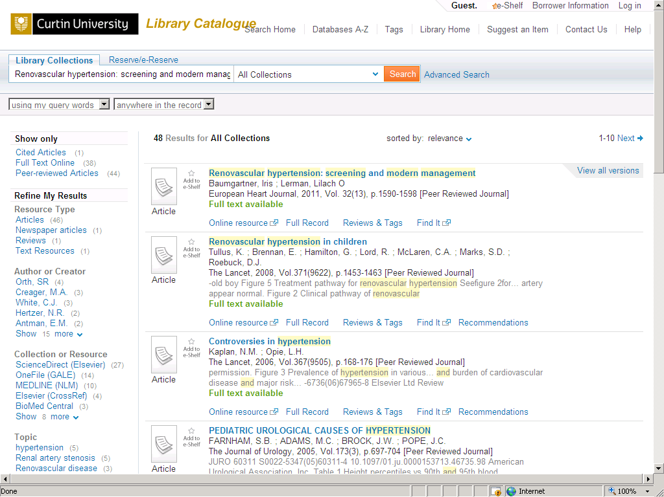

Slide 14
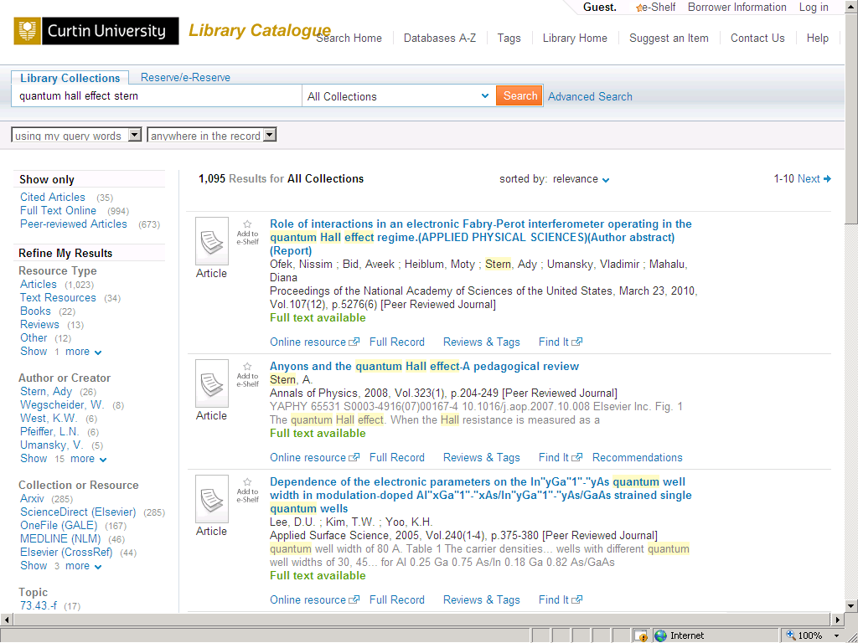

Slide 15
1
2
3
Notes:
1. What is relevance ranking, and specifically in the scholarly domain?
2. How do we assess the quality and accuracy of relevance ranking algorithms?
3. Some examples.

Slide 16
Being Methodical
Test environment, tools, and procedures
Metrics to evaluate our current success and the improvements we make
Measurements to assess the success of the changes, once implemented

Slide 17
Precision and Recall
Number of relevant documents retrieved
Precision=
Total number of documents retrieved
Number of relevant documents retrieved
Recall=
Total number of existing relevant documents

Slide 18
Evaluation Metrics
Mean Average Precision (MAP) http://en.wikipedia.org/wiki/Mean_average_precision
Mean Reciprocal Rank (MRR) http://en.wikipedia.org/wiki/Mean_reciprocal_rank

Slide 19
Infrastructure
Data
Tools
Automated process to run queries
Calculation of MAP and MRR metrics
Ad hoc changes of parameters in test environment

Slide 20
Evaluators
Academic researchers in various disciplines (physics, medicine, philosophy, anthropology, agriculture, biology)

Slide 21
Evaluation
Evaluators sent their queries of four types—broad-topic, narrow-topic, known-item, other
Two sets of the first 20 results were sent back and evaluated
One set returned by Primo
One set returned by Google Scholar
Evaluators were not aware of the origin of the sets
Evaluators marked Yes/No for every result (“should it be on the first page?”)
If No, why not

Slide 22
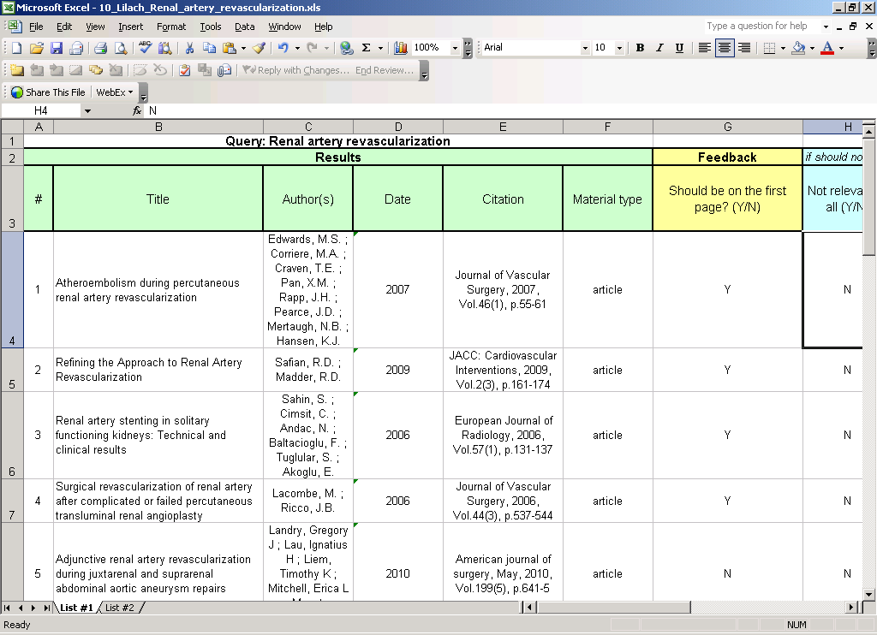

Slide 23
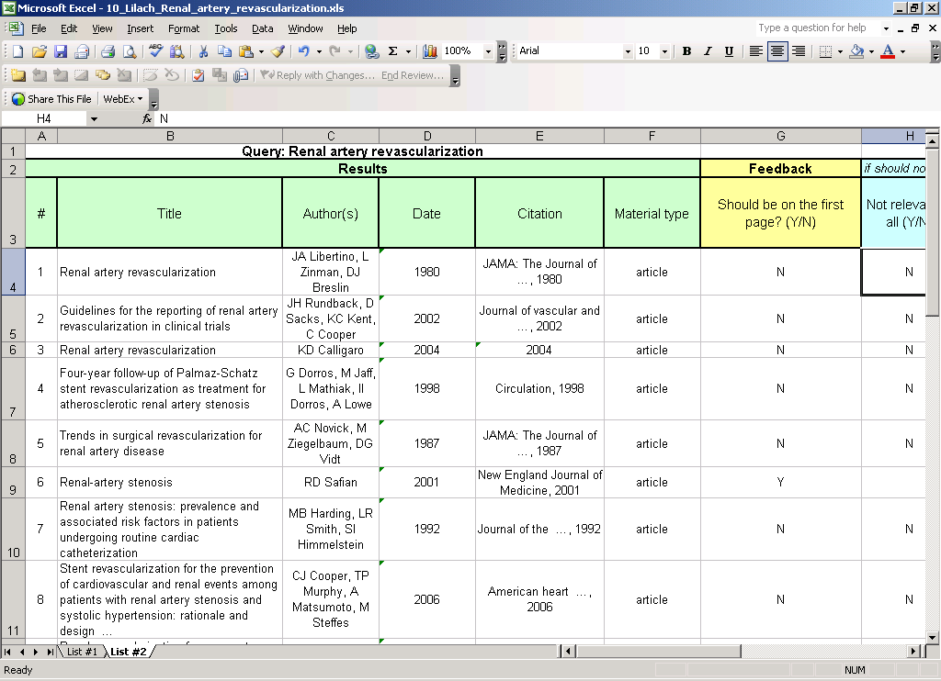

Slide 24
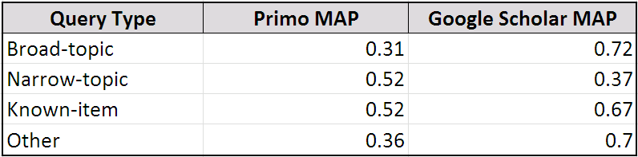
15%
MAP maximal value: 1.00

Slide 25
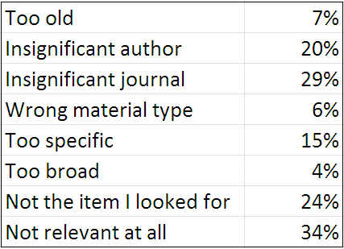

Slide 26
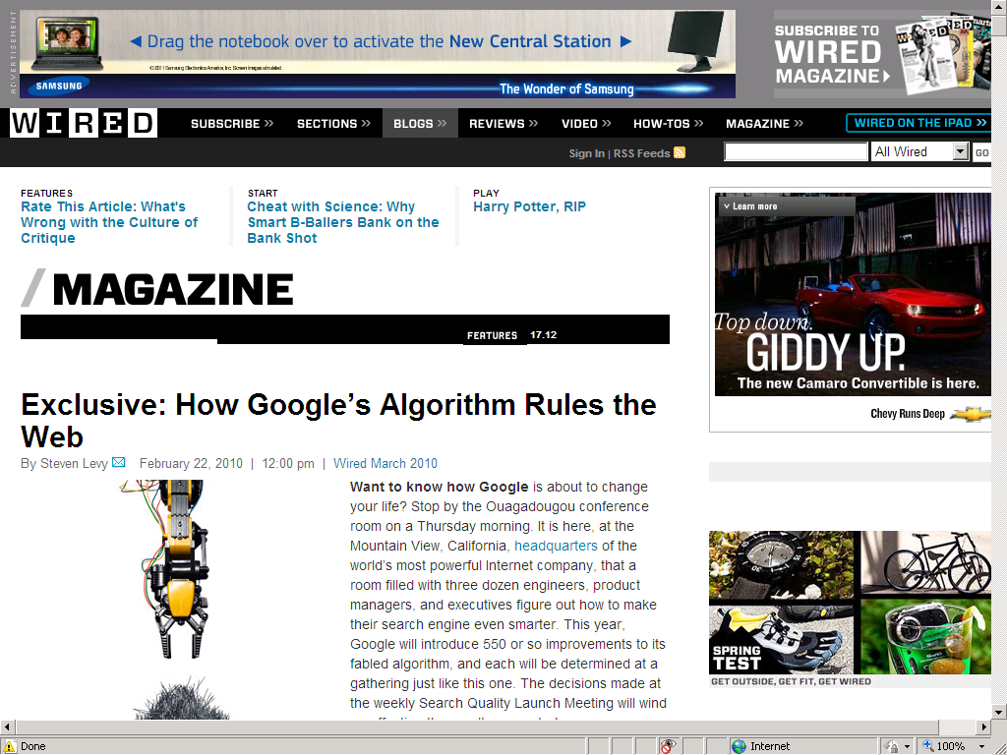

Slide 27
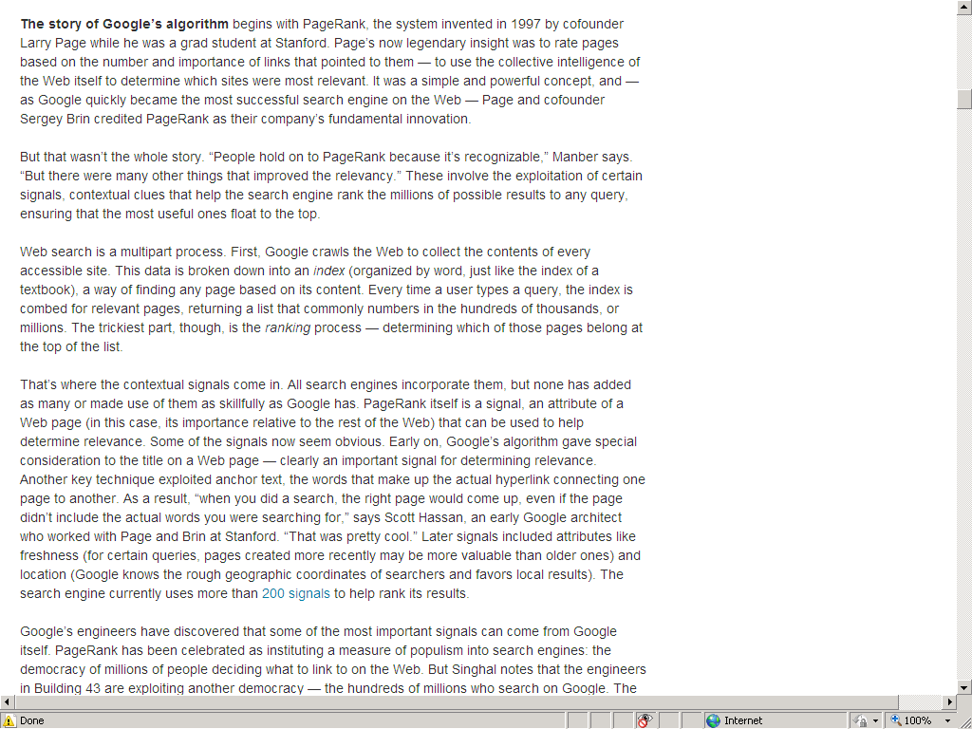


Slide 28
Monitoring after implementation
Number of times that users moved to the next page of results
Number of sessions that culminated in the selection of an item
Average number of items that were selected per session
Location of the selected items on the result list

Slide 29
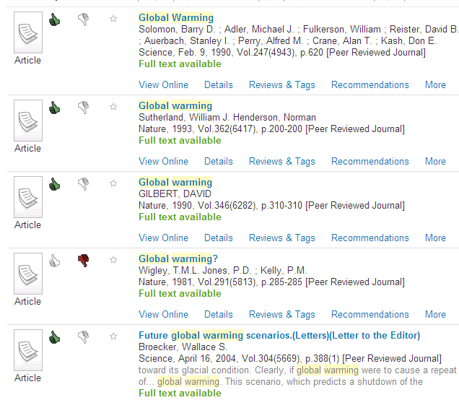
More Queries
Many more evaluators
Full scope of search
UI changed to support evaluation

Slide 30
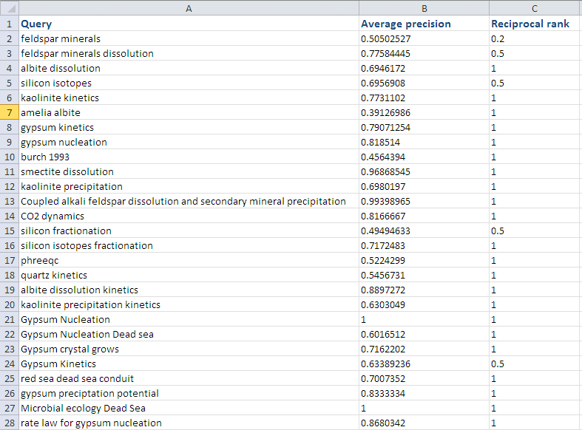

Slide 31
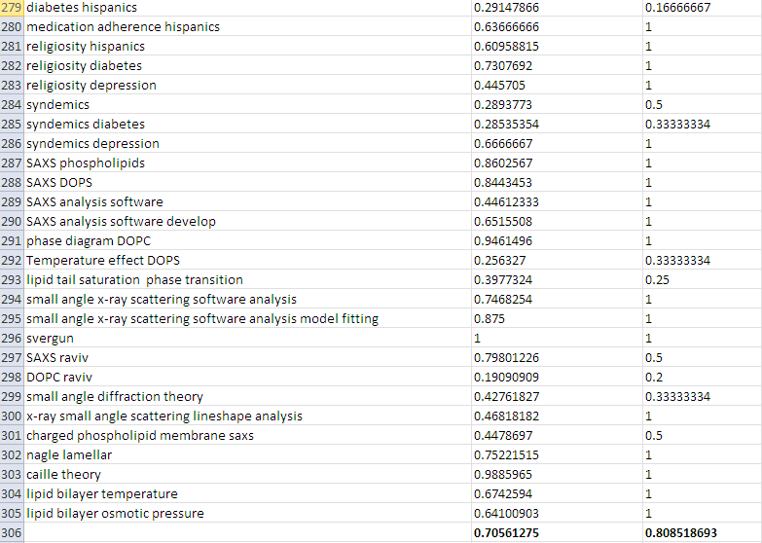

Slide 32
MAP
MRR

Slide 33
1
2
3
Notes:
1. What is relevance ranking, and specifically in the scholarly domain?
2. How do we assess the quality and accuracy of relevance ranking algorithms?
3. Some examples.

Slide 34

This is what we do
Relevance of an item is calculated based on:
The match between the query and the item
The item’s value score
The user and the information need
Local materials ranked separately and, possibly, differently from global materials
Blending of local and global materials is controlled by the library

Slide 35
The Match
Traditional IR methods, adapted to the scholarly information structure (metadata, abstract, full text).

Slide 36
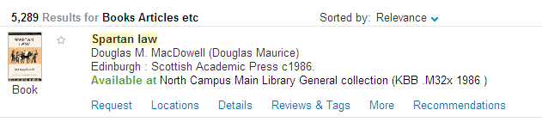
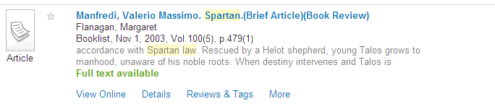
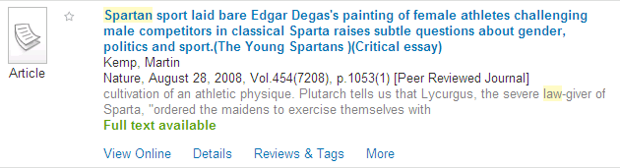
1
4
39

Slide 37
Value Score
The significance of an item, regardless of the query
Built from information about the item, based on usage and citations
Usage is available from the Ex Libris bX recommender database

Slide 38
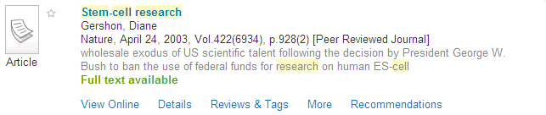
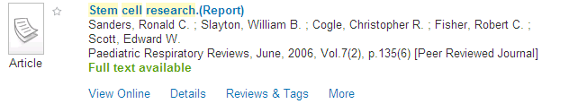
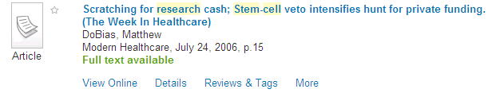
1
27
231

Slide 39
The User
Academic degree
Leverage the correlation between academic degree and type of materials used
Discipline
Focus on discipline-related materials and authors, in case of ambiguity

Slide 40
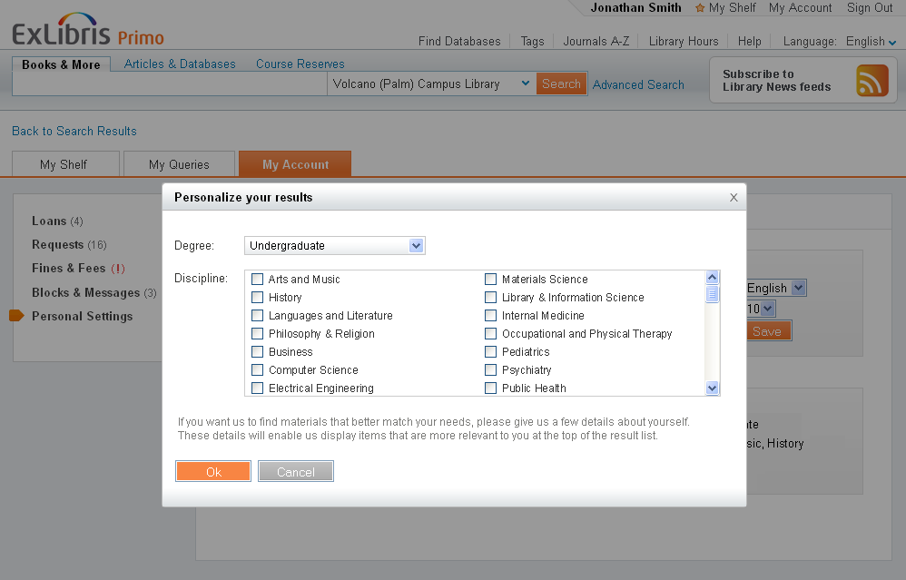
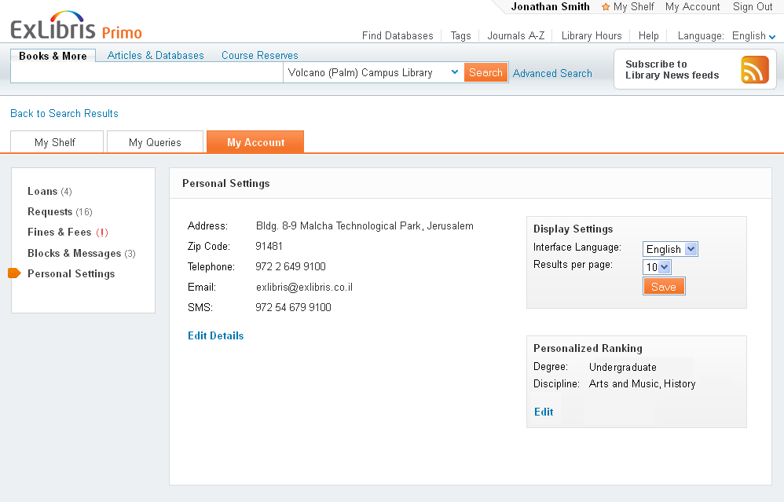

Slide 41
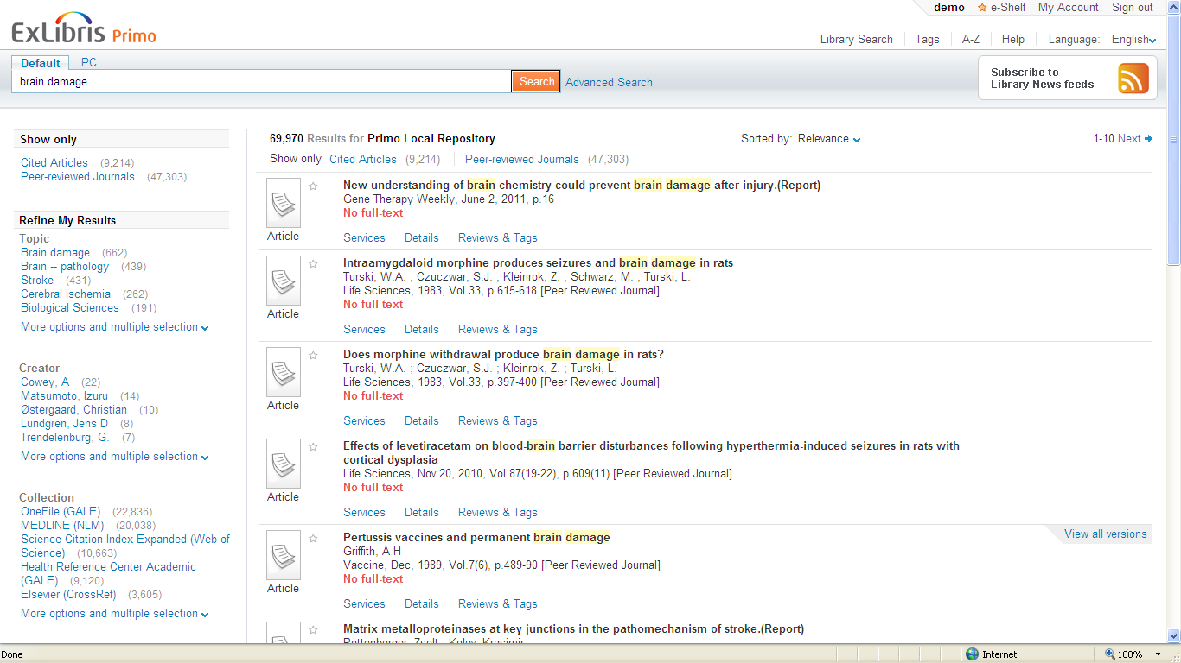
if I study Biology…

Slide 42
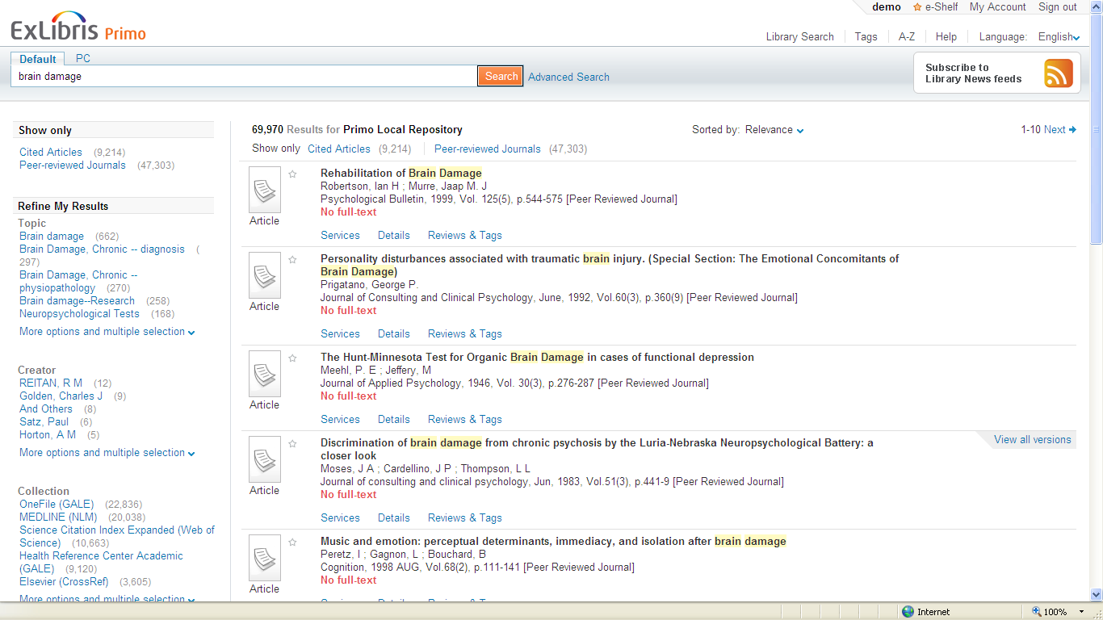
but if I study psychology…

Slide 43
The User Needs
Known-item search:
Bioinformatics. Private pact ends the DNA data war Roberts, Leslie
Narrow-topic search:
computational dna analysis
Broad-topic search
dna

Slide 44
Broad-Topic Queries
korean poetry
buddhist art
adventure education
stereoisomerism
social mobility
mining engineering
operator theory
galaxies
book collecting
canoeing
About 25%-30% of the queries, based on query logs

Slide 45
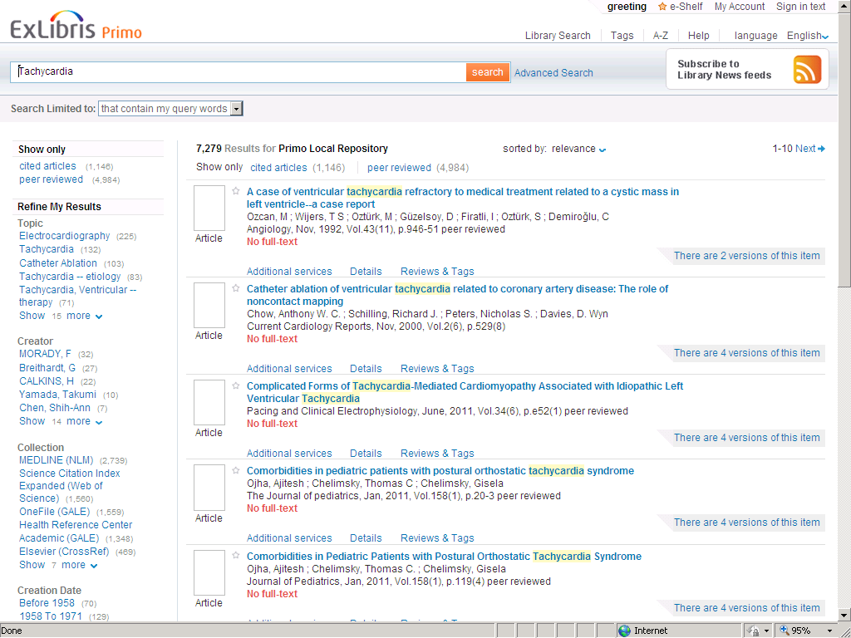
Before

Slide 46
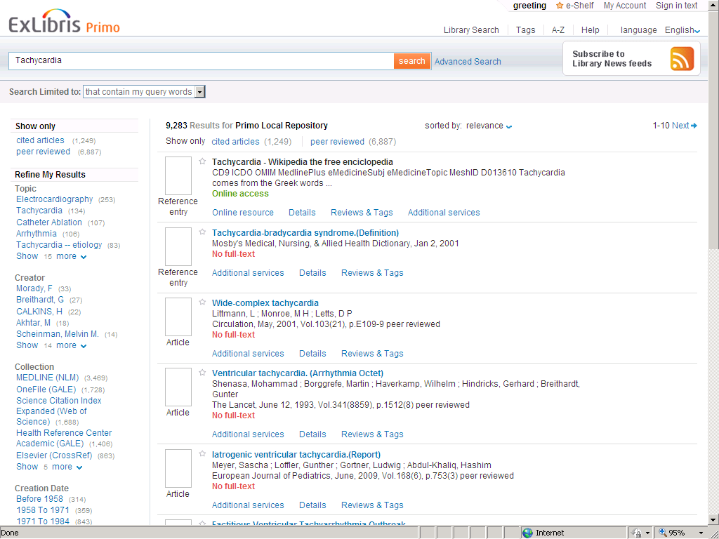
Tachycardia – Wikipedia the free encyclopedia
Tachycardia comes from the Greek words tachys (rapid or accelerated) and kardia (of the heart). Tachycardia typically refers to a heart rate that exceeds the normal range for a resting ...
After

Slide 47
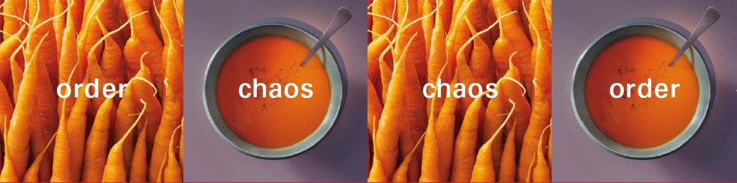


Slide 48
ScholarRank™
Query match
Item’s value score
User

Slide 49
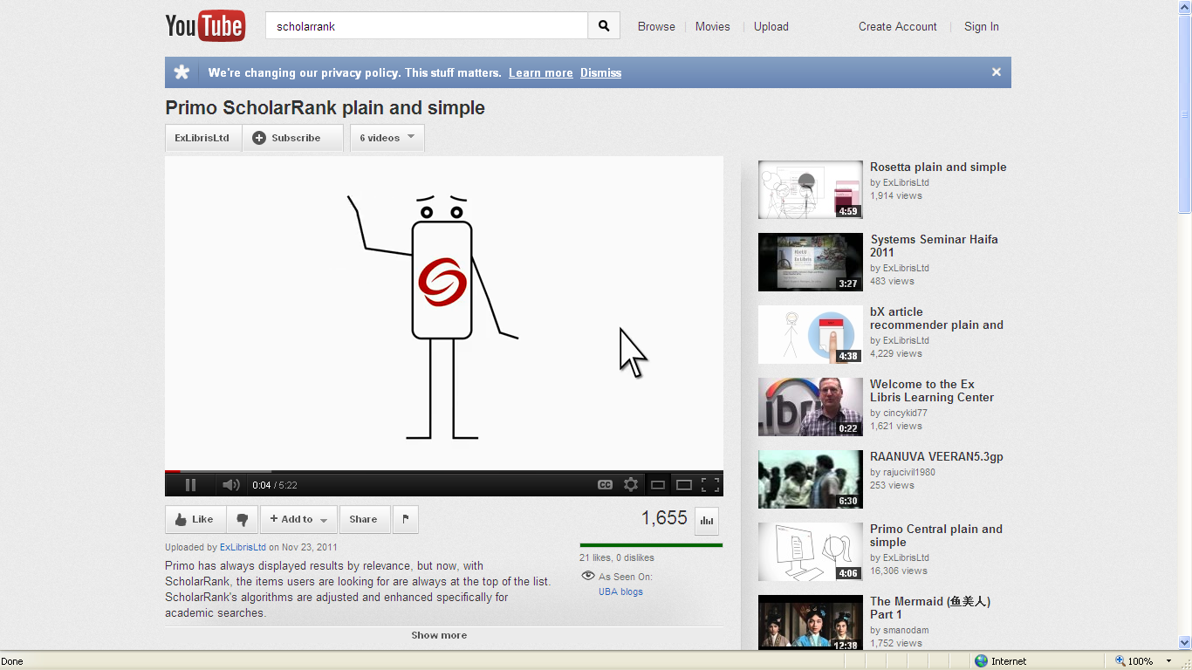

Slide 50
Bibliography
Saracevic, T. (1975). Relevance: A review of and a framework for the thinking on the notion of information science. Journal of American Society for Information Science, 26(6), 321–343.
Saracevic, T. (2007) Relevance: A Review of the Literature and a Framework for Thinking on the Notion in Information Science. Part II: Nature and Manifestations of Relevance. Journal of the American Society for Information Science and Technology, 58(13):1915–1933
http://www.wired.com/magazine/2010/02/ff_google_algorithm/all/1

Slide 51
Thank You!
Tamar Sadeh

